Slide 1
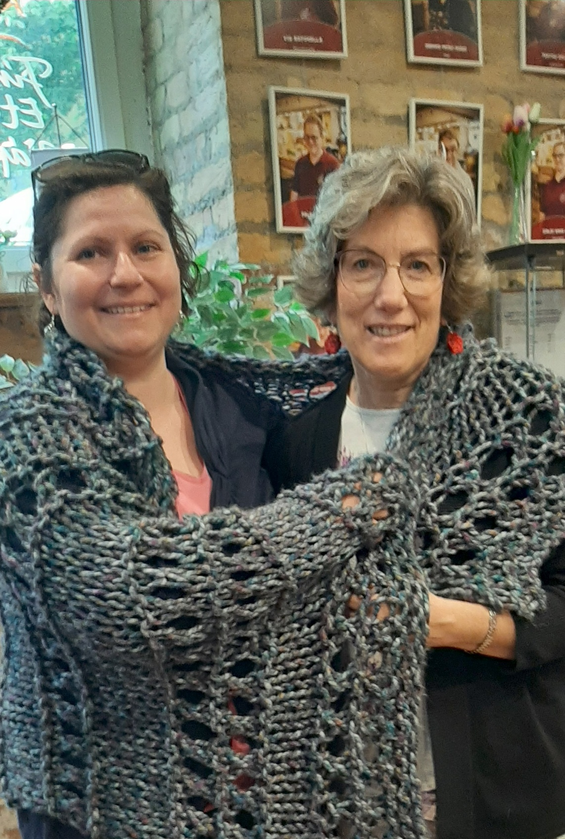
Rev. Margaret Yackel-Juleen (right) presenting a prayer shawl to Rev. Márta Bolba (left) of Mandák Ház, an inner-city Budapest outreach ministry of the Evangelical Lutheran Church in Hungary.

Slide 2
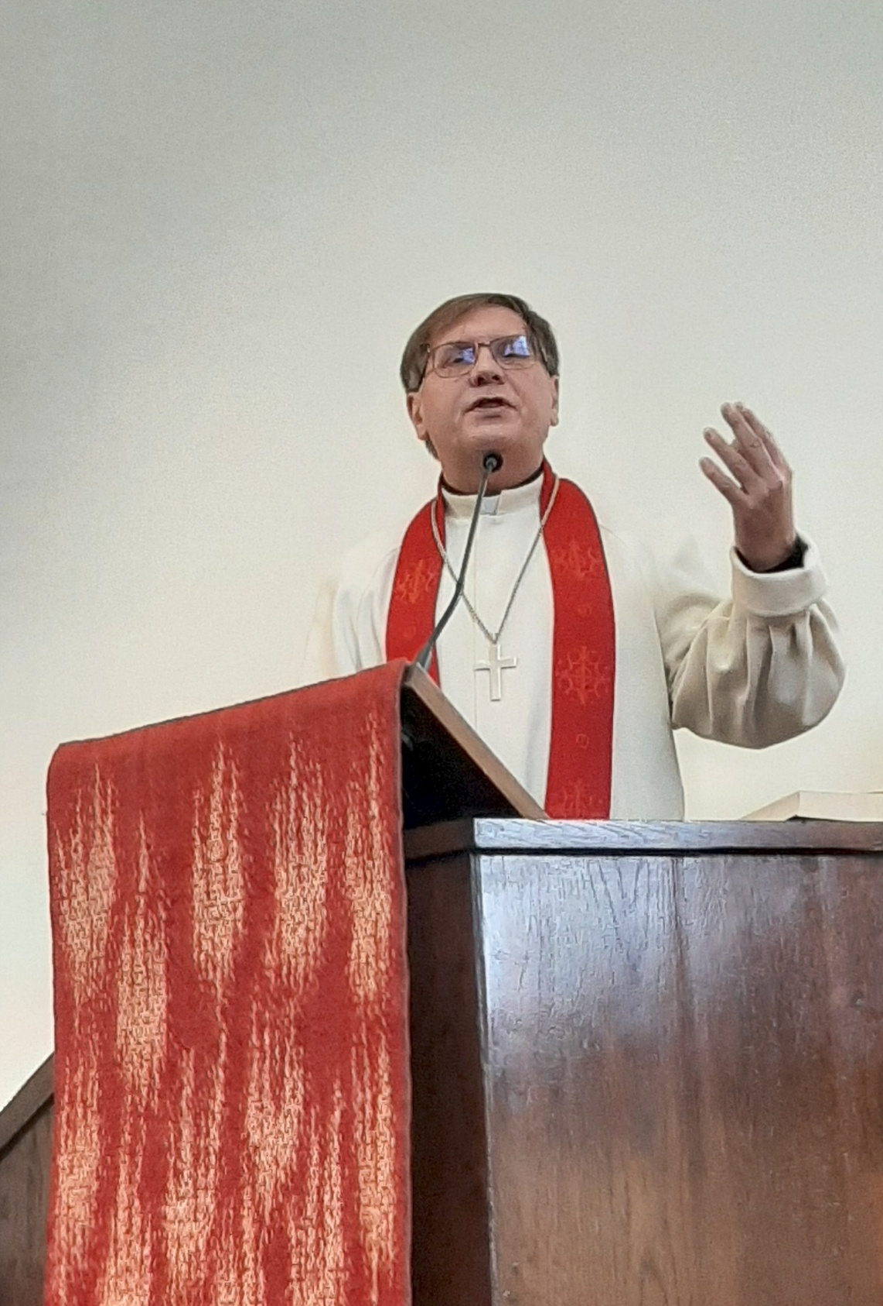
Rev. Dr. Tamás Fabiny, Presiding Bishop of the Evangelical Lutheran Church in Hungary, preaching on Pentecost Sunday at “The Bishop’s Church” in Budapest.

Slide 3
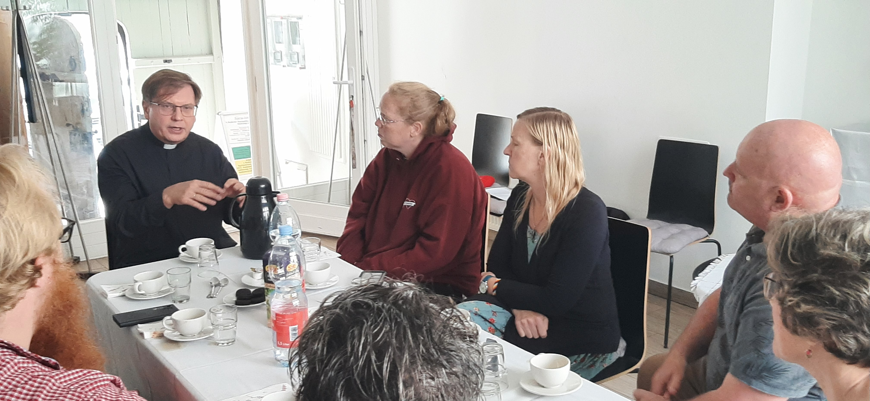
Members of the NE Iowa Synod and seminary students of Wartburg Theological Seminary discussing mission and ministry with Bishop Tamás Fabiny of the Evangelical Lutheran Church in Hungary.

Slide 4
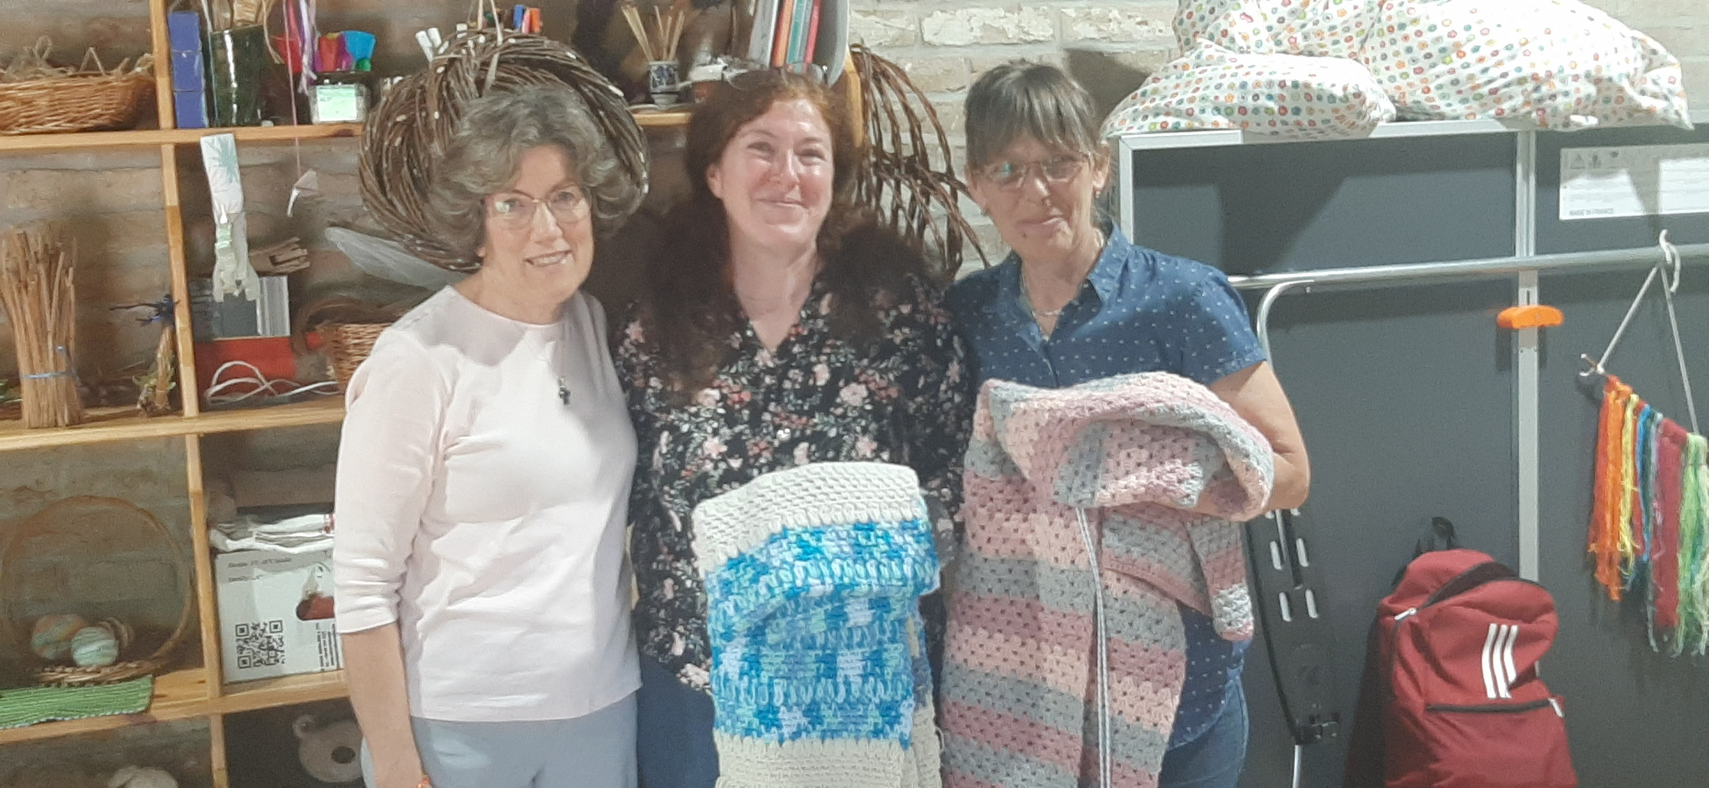
Rev. Yackel-Juleen (left) with the directors of the Roma Cultural Centre at Kötcse, Hungary which has vocational training programs funded by the ELCA.

Slide 5
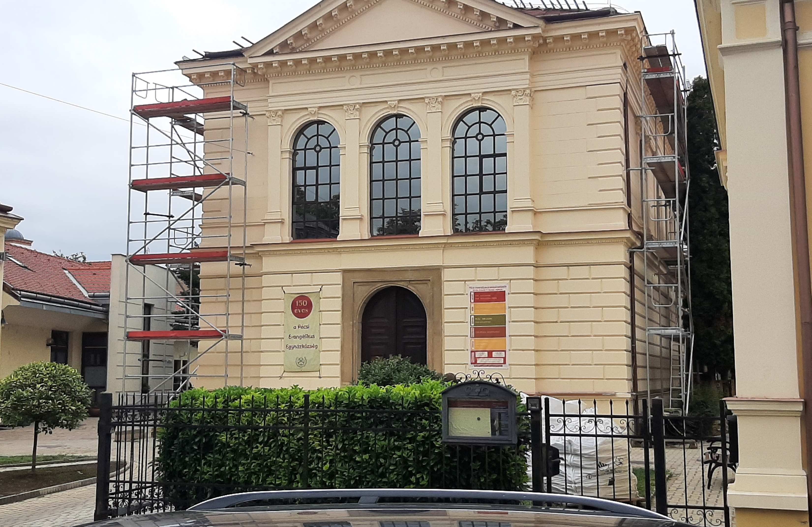
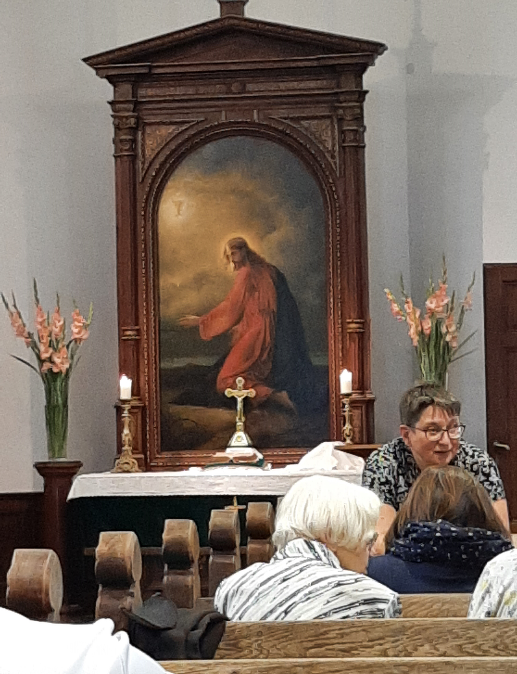
Pécs Evangelical Lutheran Church, in southern Hungary

Slide 6
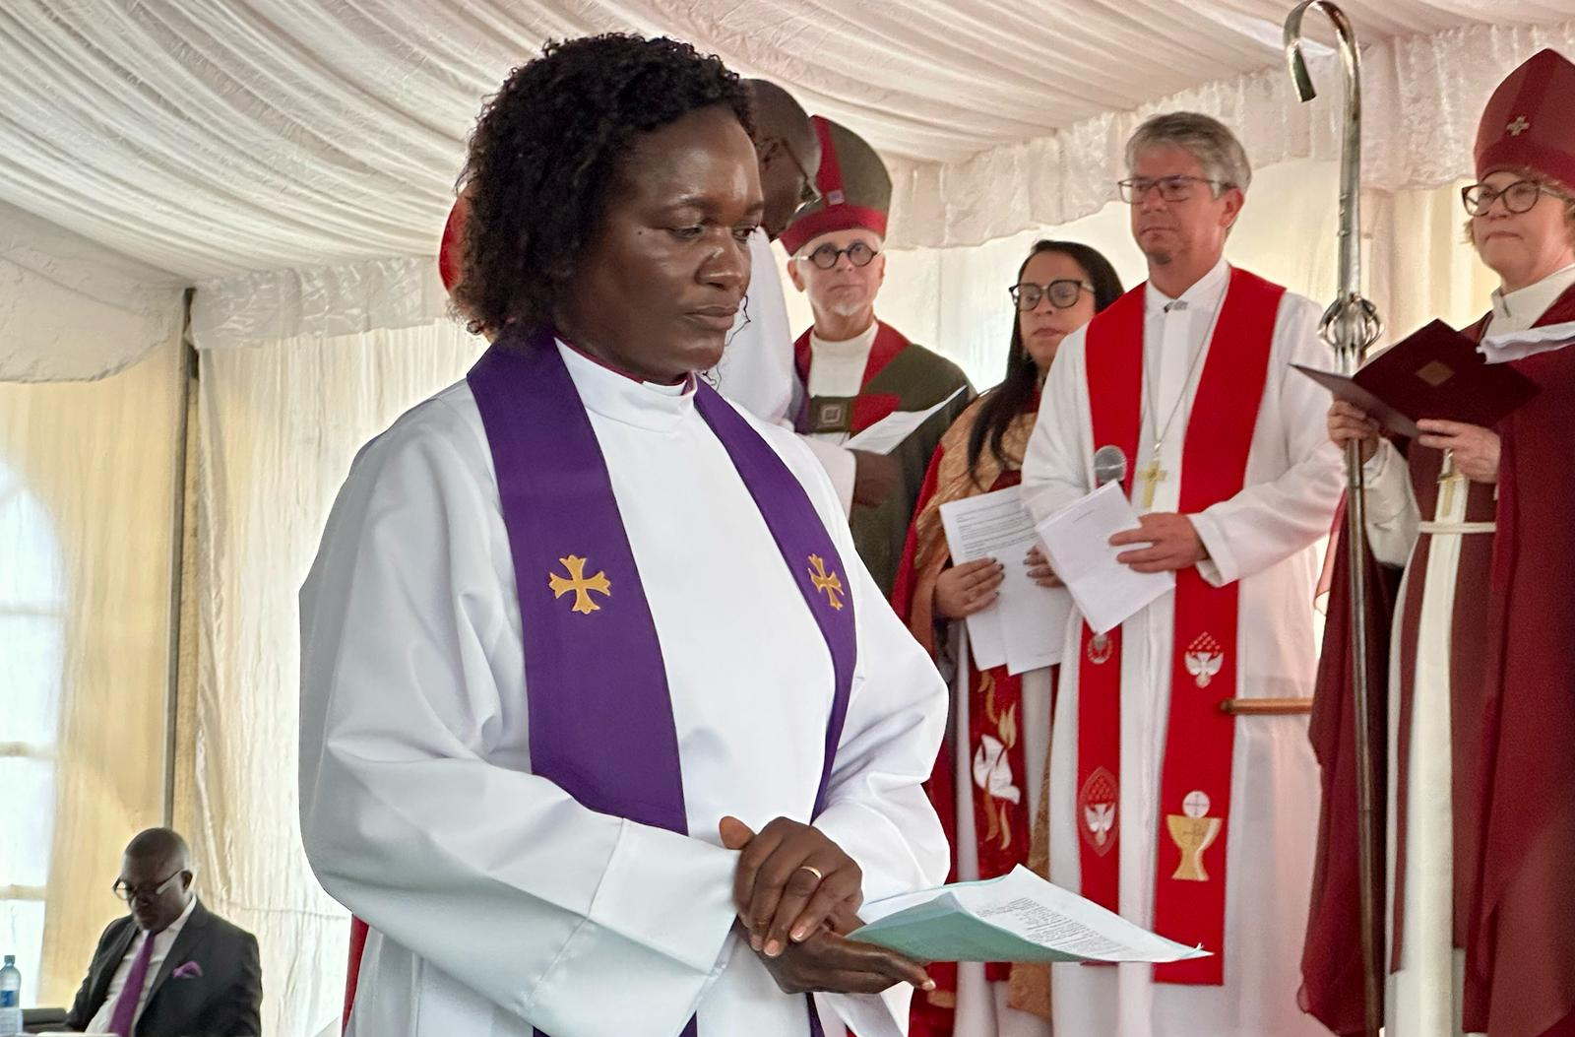
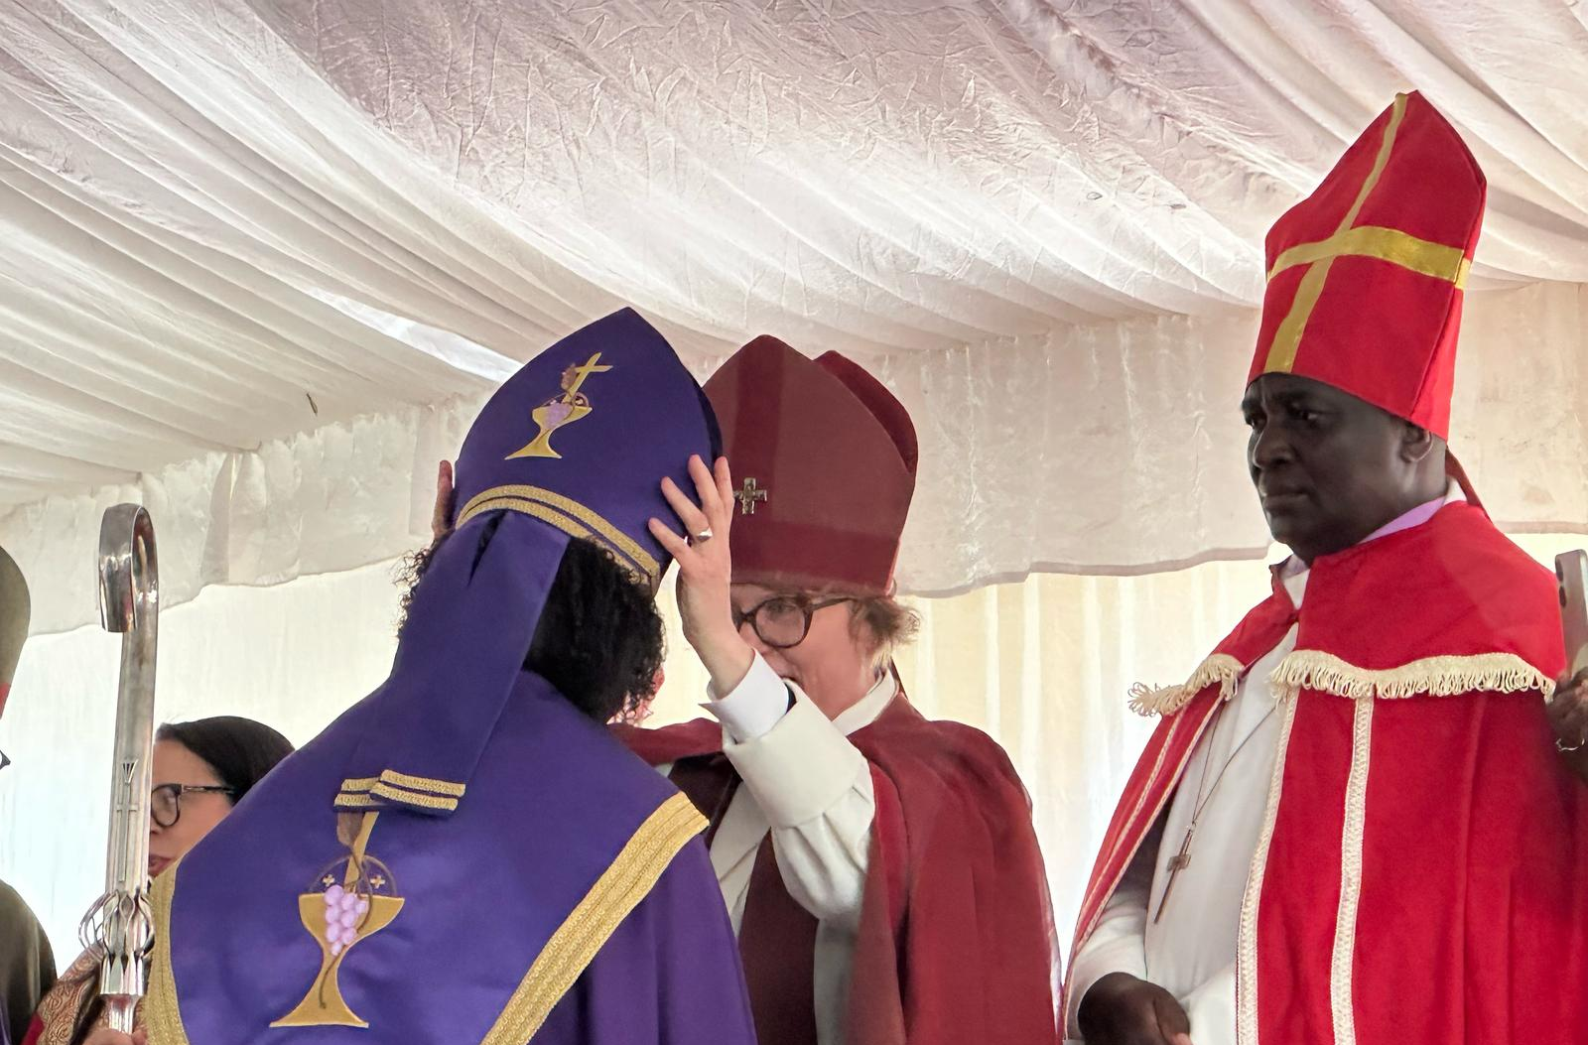
Consecration of Rev. Hilja Nghaangulwa as Bishop of the Eastern Diocese of the Evangelical Lutheran Church in Namibia. She is the first female bishop in Namibia and only the second on the continent of Africa.

Slide 7
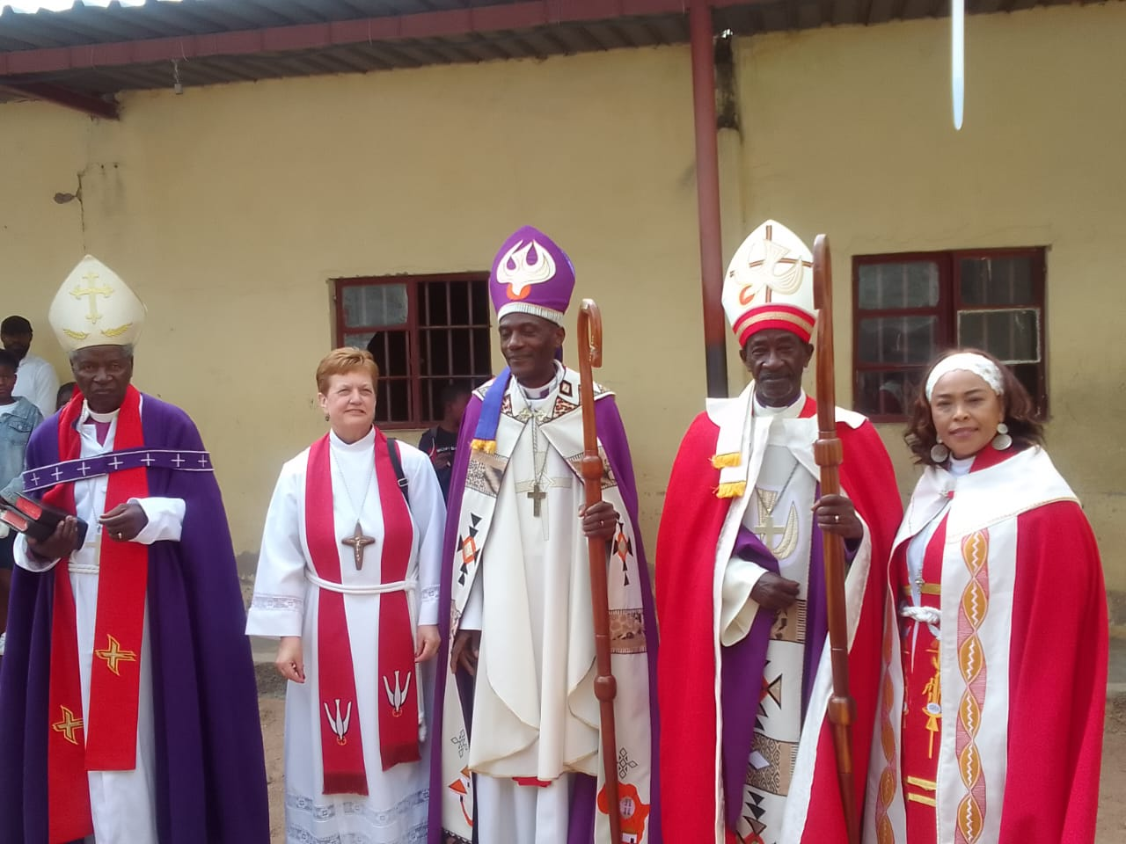
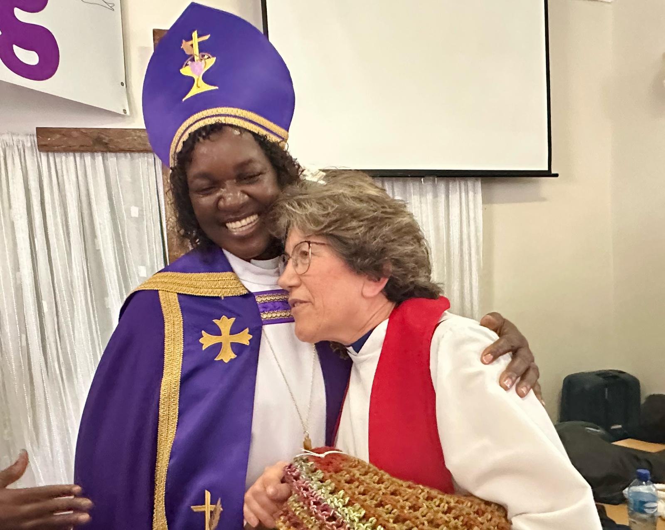
Namibian Bishop Consecrations
(Left) Rev. Margaret Yackel-Juleen of the NE Iowa Synod Global Church Together group presenting a prayer shawl to newly consecrated Bishop Hilja Nghaangulwa.

Slide 8
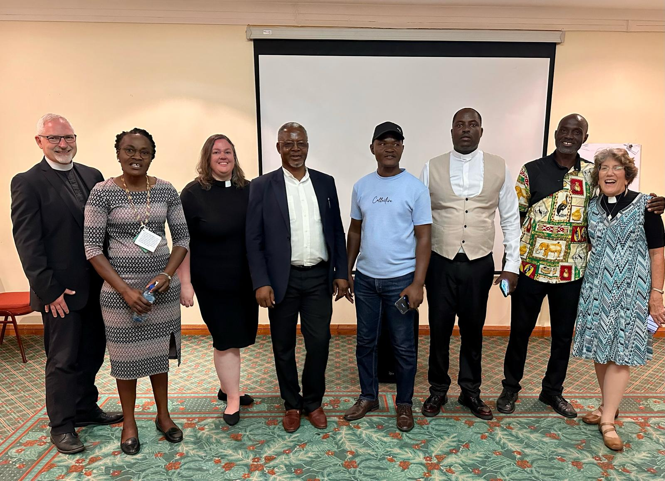
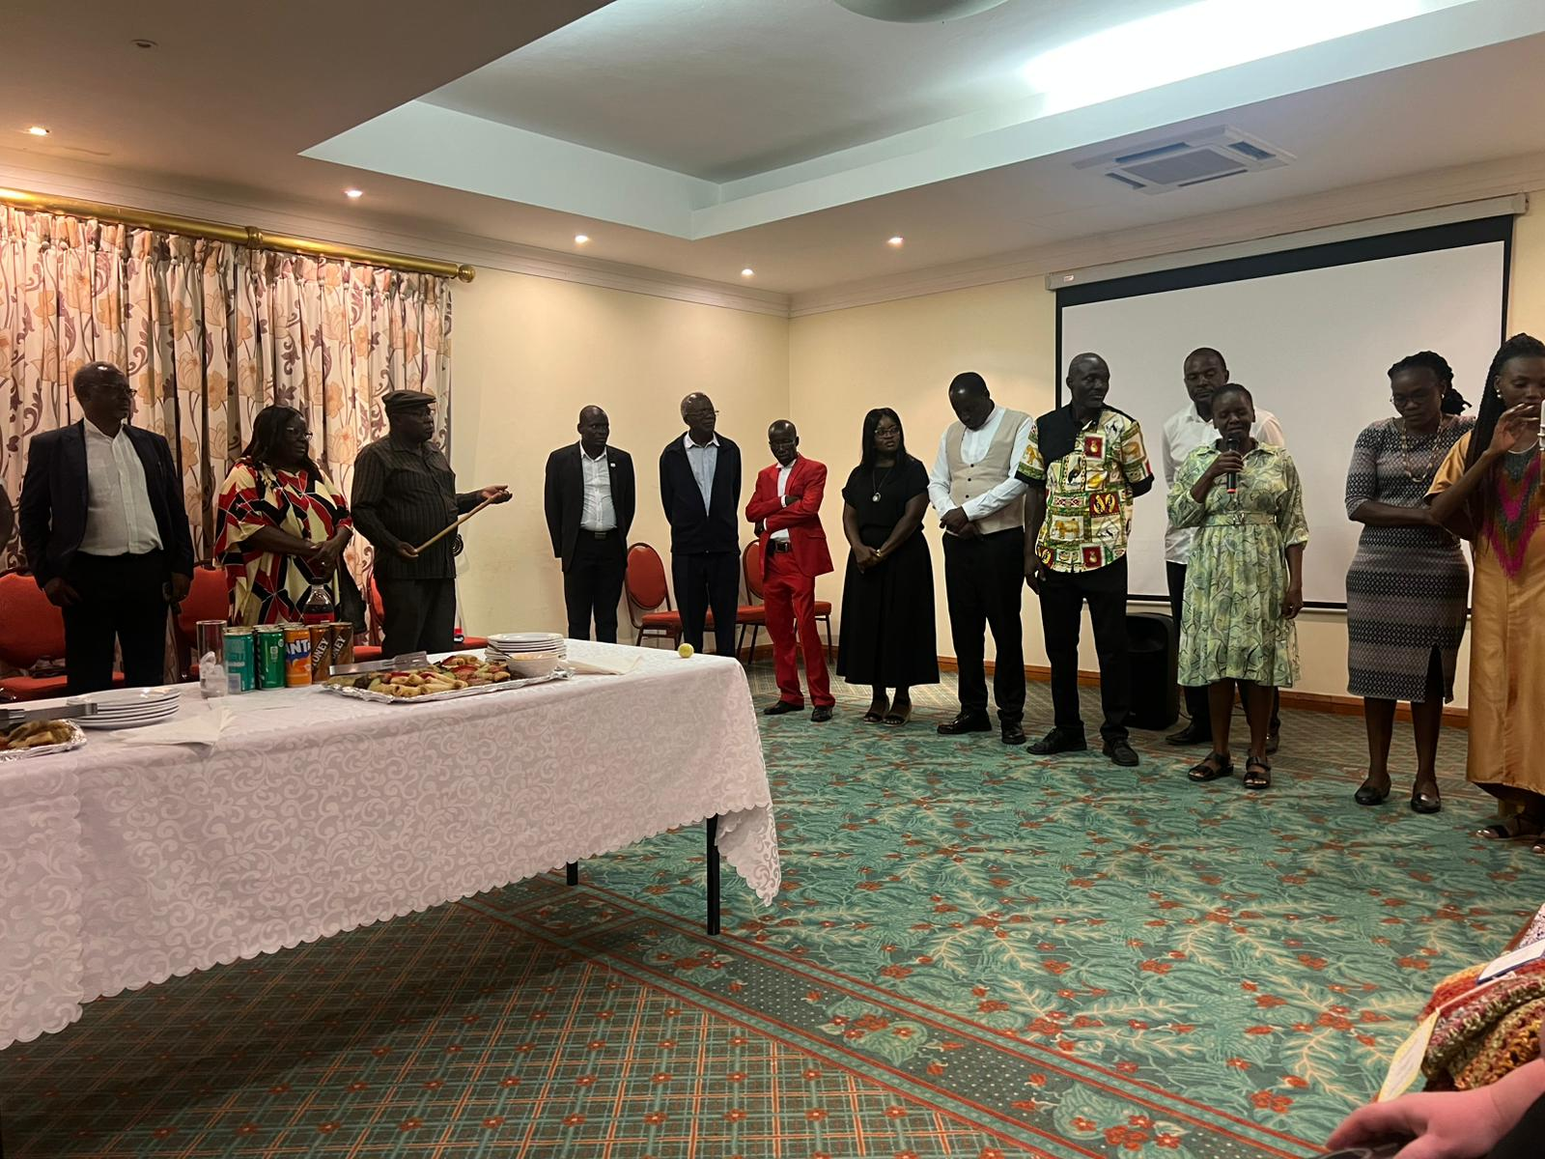
Reception to Meet Namibian Lutheran Pastors

Slide 9
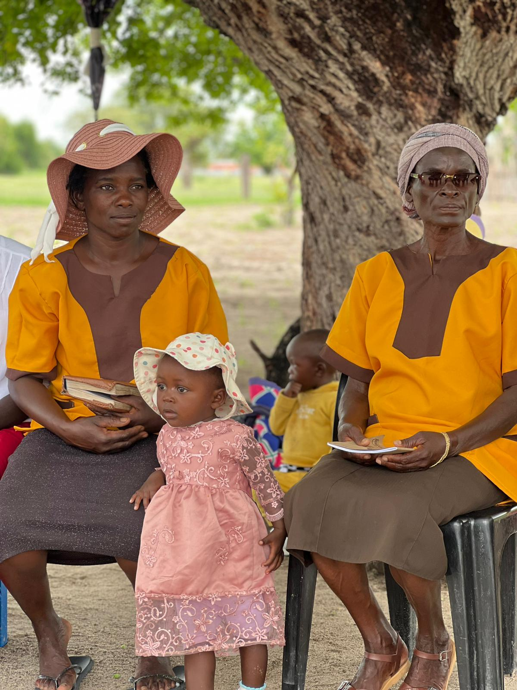
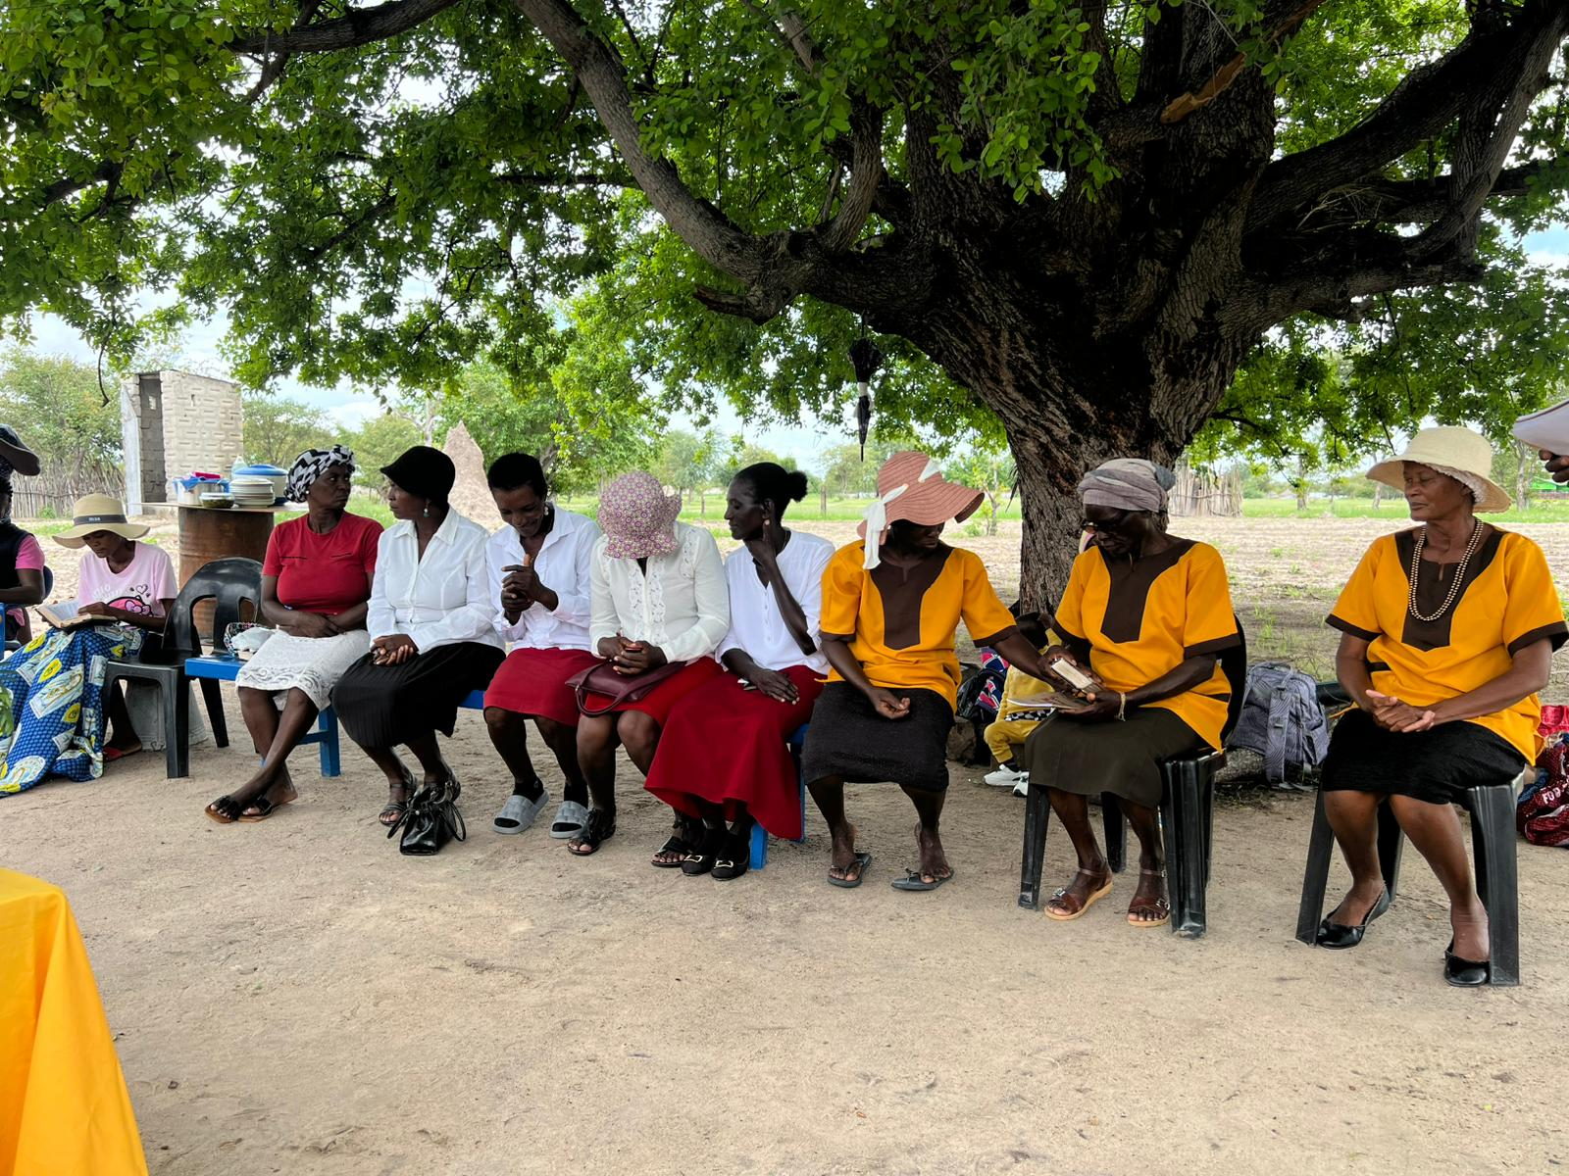
Lutheran HIV/Aids Support Group in Namibia

