Slide 1

Developing a Culture of Generosity in a Congregation

Slide 2
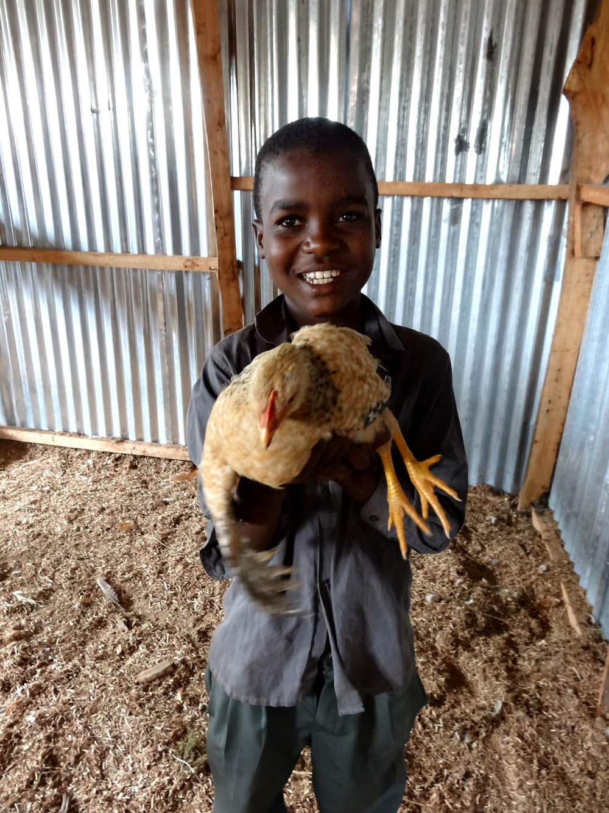
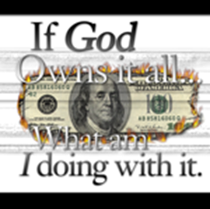
They don’t have to survive to be Christians, but they do have to be generous to be Christians.

Slide 3
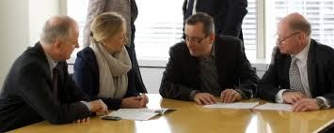
What is the role of the congregational stewardship committee?
It is to grow Christian faith through the practice of Christian stewardship, in particular, financial stewardship - just like other committees grow Christian faith through education, worship, service, fellowship, etc. A by-product of this growth in Christian faith is more financial resources to support ministries in the congregation.

Slide 4

Who Is Our Hope & Security?
One of the greatest competitors against Jesus in America today is money. Money promises hope, security, worth, and identity and is in direct competition with the good news of Jesus. Giving ourselves to God through financial offerings has always been a practice that forces us to live like God is more important than my stuff.

Slide 5
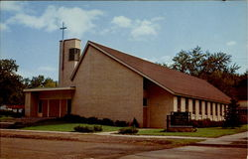
All growth in stewardship is inspired, not demanded
The congregation inspires its members by being committed, joyful, proportionate givers of its own financial resources.

Slide 6
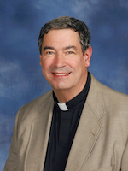
All growth in stewardship is inspired, not demanded
Pastoral and lay leadership in the congregation inspire the members and others who worship with them to grow in financial stewardship by talking about their own practice of stewardship and how it relates to their faith in the Good News of Jesus. People in the congregation will rarely grow to give more than the leaders of the congregation.

Slide 7





All growth in stewardship is inspired, not demanded
Mission interpretation will inspire people in the congregation to trust, not only God, but also, the effective management of the congregation, synod, and churchwide expressions of the church to turn their gifts into ministry.

Slide 8
Did I Just Shoot Myself in the Foot?
Retire the word “budget” in favor of “Ministry Plan”
Never talk about giving to the church; we always give to God through the church.
Never give people the impression that you are more interested in their money than you are in them as people.
Don’t emphasize designated giving. Control issues are involved.

Slide 9
All growth in stewardship is inspired, not demanded
Pastoral and lay leadership inspire people in the congregation to be thoughtful and prayerful in their decisions to give by being enthusiastic supporters of an annual opportunity for Christians to commit themselves to a disciplined level of giving.
            Consider 0.5% increase

Slide 10
What Does 0.5% Look Like?
$50,000 annual income X 0.005 = $250 annual increase
$250 annual increase / 50 weeks = $5/week increase
This is a manageable and sustainable increase
If people averaging 2% of annual income in giving increase by 0.5% of annual income, giving to the congregation would increase by 25%.

Slide 12

Rediscovering Macedonia
We want you to know, brothers and sisters, about the grace of God that has been granted to the churches of Macedonia; for during a severe ordeal of affliction, their abundant joy and their extreme poverty have overflowed in a wealth of generosity on their part. For, as I can testify, they voluntarily gave according to their means, and even beyond their means, begging us earnestly for the privilege of sharing in this ministry to the saints— and this, not merely as we expected; they gave themselves first to the Lord and, by the will of God, to us, so that we might urge Titus that, as he had already made a beginning, so he should also complete this generous undertaking among you. Now as you excel in everything—in faith, in speech, in knowledge, in utmost eagerness, and in our love for you —so we want you to excel also in this generous undertaking. 2 Corinthians 8:1-7

Slide 13
Other Texts Dealing with Christian Stewardship
Genesis 8:3f Genesis 28:16-18
Deuteronomy 26:12 2 Samuel 24:24-25
Malachi 3:10 Matthew 6:19-21
Matthew 6:19-21, 24, 25-34
Matthew 13:44-45 Matthew 23:23
Mark 10:17-27 Mark 12:41-44

Slide 14
Other Texts Dealing with Christian Stewardship
Luke 6:24-26 Luke 10:25-37
Luke 12-13-21 Luke 14:33
Luke 17:19-31 Luke 18:18-27
Luke 19:1-10*
2 Corinthians 8:1-15
Galatians 5:22 Philippians 4:15-20

Slide 15
Synod Stewardship Resources
  http://www.neiasynod.org/ministries/stewardship/

