Slide 1

MONEY
MASTER OR SERVANT?
“No one can serve two masters …” Matthew 6:24

Slide 2
Let’s
LET’S BE CLEAR
“A person is justified not by the works of the law but through faith in Jesus Christ.” Galatians 2:16
Faithful stewardship is not a set of rules we must obey to maintain our relationship with God. Instead, through God’s grace we are free to determine how best to manage and use the resources entrusted to us.
Faithful stewardship is NOT just about the portion of those resources we give away.
“We are to use all of it in ways that will please God, in ways that demonstrate our devotion to the rule of God, the lordship of Christ, and the direction of the Holy Spirit.”
Mark Allan Powell, Giving to God

Slide 3
PERSONAL MONEY AUTOBIOGRAPHY
What experiences early in your life shaped your current feelings about money?

Slide 4
MONEY: MASTER OR SERVANT?
PERSONAL MONEY AUTOBIOGRAPHY
How were your attitudes toward money shaped by the experiences and attitudes of your family?

Slide 5
MONEY: MASTER OR SERVANT?
PERSONAL MONEY AUTOBIOGRAPHY
What have been the strongest influences on the way you manage money in your household today?

Slide 6
MONEY: MASTER OR SERVANT?
PERSONAL MONEY AUTOBIOGRAPHY
How does your faith guide the use of your money?

Slide 7
MONEY: MASTER OR SERVANT?
PERSONAL MONEY AUTOBIOGRAPHY
Are you trying to make significant changes in the way you manage now and for the future?

Slide 8
MONEY: MASTER OR SERVANT?
PERSONAL MONEY AUTOBIOGRAPHY
How have your feelings and attitudes about giving money to the church and other charitable causes changed over time?

Slide 9
MONEY: MASTER OR SERVANT?
PERSONAL MONEY AUTOBIOGRAPHY
Did any of your answers to the money autobiography questions surprise you?

Slide 10
God’s Word says a lot about our relationship with money (wealth, possessions).
Why would God care how we regard, acquire, manage, and spend money?

Slide 11
HOW WE REGARD MONEY
The danger of prosperity – abundance can cause us to lose our focus on God.
A tool and resource to enable us to love and serve God and our neighbor.
A positive gift – received with gratitude.
God does not value His children on the basis of their wealth – He stands with the poor.
Trust in God’s continuing benevolence.

Slide 12
QUESTIONS
Can enjoyable material blessings that enrich our lives become necessities we cannot live without?
Can we be tempted to shift from trusting that God will provide all we need to trusting our wealth to protect us from a diminishing “standard of living”?
How can we avoid allowing income and wealth to become measures of a person’s worth or value – applied either to our neighbors or ourselves?

Slide 13
HOW WE ACQUIRE MONEY
We are to deal with our neighbors honestly.
(Who is our neighbor?)
Our employment is a calling through which we can serve and witness to our neighbors.
Even those not needing a paycheck should be engaged in the good of their community.
Work is good -
God expects us to work.
Our means of acquiring money should not create hardships for our neighbors.

Slide 14
QUESTIONS
What makes a job a calling or vocation?
Is it possible to tell someone who you are without referring to your current or former occupation?
What would you tell a child, grandchild, or other young person asking for guidance about what to do with his or her life?

Slide 15
HOW WE MANAGE MONEY
A means of furthering God’s purpose of extending His love and grace to family, friends and neighbors.
Nor should we waste or squander the resources God has entrusted to us.
Planning and saving for future needs is not hoarding (within reason!?).
Faithful stewards of all with which God has entrusted us.
Beware of hoarding – we won’t take it with us.

Slide 16
QUESTIONS
How would you define the line between wise and prudent planning for the future and hoarding wealth?
What is a faithful guideline for choosing between a clear current need like providing for hungry families in your community and a possible future need like a longer than expected retirement?
What constitutes faithful stewardship of wealth we have saved for legitimate future needs?

Slide 17
HOW WE SPEND MONEY
We have freedom to decide whether our spending is worthwhile for ourselves and our families.
Faithful stewardship includes responsible self-care as well as caring for others.
Our spending decisions should consider the impact on others as well as ourselves.
Faithful spending involves giving up the love of possessing.
With freedom comes the responsibility to use resources faithfully.

Slide 18
QUESTIONS
Can our God-given freedom to discern what spending is truly faithful for ourselves and our families become a stumbling block for our neighbors?
How does telling our children “We can’t afford that.” differ from “We don’t think that would be a good use of our money.”?
Is it possible that spending more moderately (or frugally) could increase our enjoyment of life?

Slide 19
HOW DOES GIVING FIT INTO THIS FRAMEWORK?
Generous giving is a key aspect of faithful stewardship.
Giving is the way those to whom God has given the talent to make money and accumulate wealth can employ the fruit of that talent to God and neighbors.
Giving helps release the hold money has on us as a competing source of hope, worth, and security – all of which really come through God’s love and grace.

Slide 20
QUESTIONS
Should we base our giving decisions on our feeling about the worthiness of the project (as directed by our hearts), or place a priority on meeting the ongoing month to month needs of our congregation (even when we find it hard to be cheerful about such routine giving)?
As long as we give to our congregation or for another worthwhile purpose, does it make any difference why we give?
Does paying our pledge to our congregation through a direct deposit program seem like as much of an act of worship as placing a contribution in the collection plate?

Slide 21
WHAT OTHER INSIGHTS ABOUT HOW OUR RELATIONSHIP WITH GOD AFFECTS OUR RELATIONSHIP WITH MONEY (AND VICE VERSA) COULD WE ADD?

Slide 22
TRANSLATING FAITH-BASED VALUES INTO SPECIFIC FINANCIAL GOALS
A SMART financial goal is:
Specific
Measurable
Achievable
Realistic
Trackable

Slide 23



EXAMPLE
Bob (age 33)
Sue (age 31)
Chris (age 8)
Should graduate from high school in May, 2027

Slide 24
BOB & SUE
My values and goals to enable me to live them out
VALUES THAT GUIDE MY LIFE DECISIONS
We want Chris to have the opportunity to fully develop her talents and abilities.

Slide 25
BOB & SUE
My values and goals to enable me to live them out
FINANCIAL DIMENSIONS OF MY VALUES
Make it financially possible for Chris to go to college if she chooses to do so.

Slide 26
BOB & SUE
My values and goals to enable me to live them out
MY GOALS TO ENABLE ME TO LIVE OUT MY VALUES
Long Term: Save 50% of the cost of attending college by the fall of 2027

Slide 27
BOB & SUE
COST FOR ONE YEAR AT IOWA STATE UNIVERSITY
(not a college choice – just a measuring tool)
2017-18 Undergraduate Costs for an Iowa Resident
Tuition & Fees, Room & Board, Books & Supplies, and Estimated Personal Expenses
$20,606

Slide 28
BOB & SUE
AVERAGE ANNUAL INCREASE IN COLLEGE EXPENSES
Public 4-Year Colleges, In-State Students 2007-08 to 2017-18
4.31%
(2.69% Above Average Inflation Rate)
College Board and Bureau of Labor Statistics

Slide 29
BOB & SUE
Projected Cost for One Year at Iowa State University
2027-2028
$31,432
Projected Average Annual Cost over 4 Years
Beginning Fall, 2027
$33,553
Goal: Save 2 Years of College Costs by Fall, 2027
$67,106

Slide 30
BOB & SUE
HOW MUCH DO THEY NEED TO SAVE?
Average Annual Rate of Return
College Savings Iowa 529 Plan
Conservative Growth Portfolio – 10 Years Ending March, 31, 2018
5.49%
Monthly Savings to Save $67,106 in 10 Years
$420.93

Slide 31
BOB & SUE
Is their goal for saving for Chris’ education?
Specific
Yes
Measurable
Yes
Achievable
Need more information
Realistic
Need more information
Trackable
Yes

Slide 32
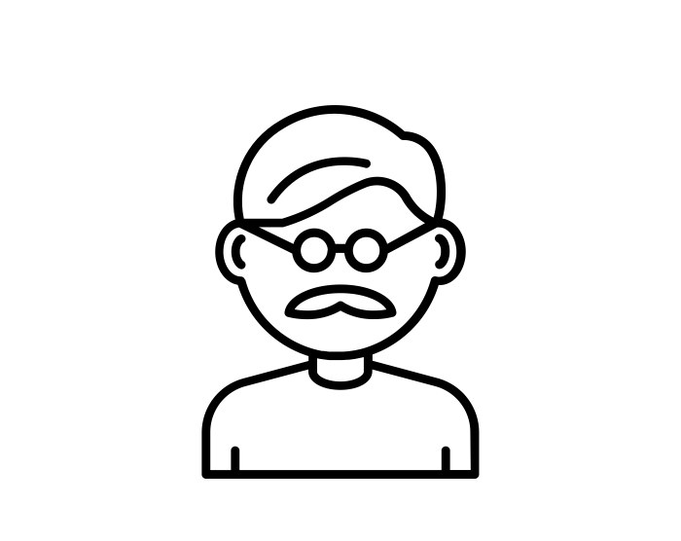

EXAMPLE
Carl (age 73)
Jean (age 72)

Slide 33
CARL & JEAN
RETIRED
Projected 2018 Income:
Combined Social Security Benefits
IRA Required Minimum Distributions
Taxable Interest
Total
$36,000
$18,000
$10,000
$64,000

Slide 34
CARL & JEAN
My values and goals to enable me to live them out
VALUES THAT GUIDE MY LIFE DECISIONS
We express our gratitude through generosity.

Slide 35
CARL & JEAN
My values and goals to enable me to live them out
FINANCIAL DIMENSIONS OF MY VALUES
We are grateful that we have been blessed with financial resources that enable us to tithe and we would like to stretch and help with a special project.

Slide 36
CARL & JEAN
My values and goals to enable me to live them out
MY GOALS TO ENABLE ME TO LIVE OUT MY VALUES
Short Term: Increase our annual giving from $6,000 to $7,000

Slide 37
CARL & JEAN
SHOULD THEY MAKE THEIR CHARITABLE CONTRIBUTIONS AS QUALIFIED CHARITABLE DISTRIBUTIONS (QCD) FROM IRA’S?
Actual Income
Charitable Contributions
Taxable Portion of Social Security Benefits
Adjusted Gross Income
Taxable Income
Federal Income Tax
Giving Directly
$64,000
$7,000
$7,000
$35,000
$9,100
$910
QCD
$64,000
$7,000
$3,500
$24,500
$0
$0

Slide 38
CARL & JEAN
Is their goal of increasing their charitable giving by $1,000 in 2018?
Specific
Yes
Measurable
Yes
Achievable
Yes
Realistic
Yes
Trackable
Yes

Slide 39
EVALUATION QUESTIONS
Was the Money Autobiography an interesting and helpful exercise?
Was the discussion of the Money Autobiography helpful? Was it too intrusive or uncomfortable?
Was the “Some Guidance from God’s Word” discussion outline interesting and helpful? Did it present a faithful interpretation of the Biblical references used to support specific points?
Could the combination of the Money Autobiography and the “Some Guidance from God’s Word” discussion outline be used as the basis for an adult forum without the practical application discussion?
Is the “Values and Goals” worksheet a logical and helpful “connection” between the values based discussion and the practical application of putting those values into action?

Slide 40
EVALUATION QUESTIONS
Were the “Bob and Sue” and “Carl and Jean” examples helpful in illustrating the connection between values and application to practical “real life” situations?
How could we most effectively connect application of faith-based values to the practical financial management challenges that are most important to our audience?
How can we most effectively structure the presentation of these materials?
Overall, do the “Money: Master or Servant?” materials have potential as useful tools for congregations and their members?
How could these materials be improved?

Slide 41
A Project of the Generosity Network
Northeastern Iowa Synod
Evangelical Lutheran Church in America
Graphics by Miranda Fober, Wartburg College Class of 2018
June, 2018

